Slide 1
43
The
scale
of the
guide
42
41
40
39
38
37
36
35
34
33
32
31
30
29
28
27
26
25
24
23
22
22
21
20
19
18
17
16
15
14
13
12
11
10
9
8
7
6
5
4
3
2
1

Slide 2
H₀ :
H₁ :
?
µ = 11
σ = ?
µ = 11
σ = ?
µ = ?
σ = ?
How long do boxer dogs live?
14
We would like to find out whether boxers differ from the other breeds in longevity. You’ve heard that dogs live 11 years on average. You ask around and meet 10 people who owned a boxer in the past. Each of them tell you how old was their dog when it died.
13
12
11
10
9
8
7
6
5
4
Notes:
Hypothesis Testing involves comparative evaluation of two claims that describe reality.
If we 1) know the language of hypothesis testing (can formulate the claims verbally and mathematically)
and 2) know how to put a number on “trueness” of each hypothesis
We can answer research questions with scientific rigor – participate in science.
We want to know how long boxer dogs may live. We know that life expectancy can vary from breed to breed, but we don’t know how much. So our guess is that boxer dogs live about 11 years.
We start asking around and found 10 people who had boxers, so they reported how long each of their dogs lived. (Red squares)

Slide 3
Group Comparison with T-tests
Visual Guide

Slide 4
Population of UNTREATED mice
Population is known
?
σ
µ = 18
σ = 4
µ = ?
σ = 4
Population of TREATED mice
Notes:
This is what we’ve been dealing with so far. In order to make see if treatment had effect, we looked to see whether the application of treatment makes the population different. For this we compared distributions of two HYPOTHETICAL populations : UNTREATED and TREATED.

Slide 5
Population of UNTREATED mice
Population is known
?
H₀ : µ₁ = µ₂
H_{A} : µ₁ ≠ µ₂
σ
22
µ = 18
σ = 4
µ = ?
σ = 4
Population of TREATED mice
Notes:
We formulated hypotheses that rigorously defined our expectation (the NULL, the Rule) and what we need to see to disprove this rule ( alternative).
We collected data and found the sample mean

Slide 6
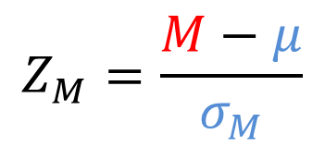
Population of UNTREATED mice
Population is known
?
H₀ : µ₁ = µ₂
H_{A} : µ₁ ≠ µ₂
σ
22
µ = 18
σ = 4
µ = ?
σ = 4
Retain H₀
Z-test :
Reject H₀
Population of TREATED mice
$$Z_{M}=\frac{M−μ}{σ_{M}}$$
Z_{M}
Z_{M}
Notes:
We knew how likely this sample mean to occur by chance because we knew:
1) true population mean
2) true population standard deviation
When the difference between the sample mean and population mean was SIGNIFICANTLY greater than expected by chance ( by 1.96 times to be specific) we’d conclude that UNTREATED and TREATED were singificantly different, hence there was a TREATMENT effect.

Slide 7
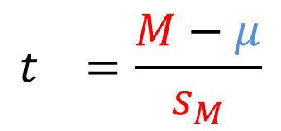
Your best Guess
Population is NOT known
?
σ
22
µ = 18
σ = ?
µ = ?
σ = ?
Retain H₀
Z-test :
T-test :
Estimated using sample
$$Z_{M}=\frac{M−μ}{σ_{M}}$$
$$t_{}=\frac{M−μ}{s_{M}}$$
Z_{M}
Z_{M}
Notes:
In most situation, we don’t know the properties of the population ( M, SD)
We don’t have the previous studies to fall back onto, so we have to formulated “the rule” ourselves. Or more exactly, what we think the rule should be based on the information that is available to us at the moment. If we see the evidence to develop some rule from data, we’d gladly accept it.
Because we don’t know the natural variability of the (UNTREATED) population, we don’t know what difference between the means we should consider “typical” or something we should expect to occur naturally, due to sampling variability.
Our null hypothesis becomes our best guess.
If we had to guess to formulate the null, we have even less premonition about what the sample would show us.
Therefore, we are being openminded and willing to consider that the sample would provide us with accurate estimation of the population mean ( the value for our alternative hypothesis)

Slide 8
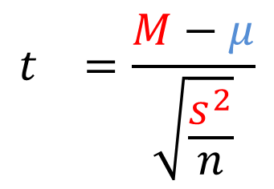
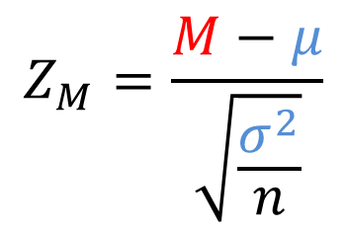
Your best Guess
Population is NOT known
?
σ
22
µ = 18
σ = ?
µ = ?
σ = ?
Retain H₀
Z-test :
T-test :
Estimated using sample
$$Z_{M}=\frac{M−μ}{\sqrt{\frac{σ^{2}}{n}}}$$
$$t_{}=\frac{M−μ}{\sqrt{\frac{s^{2}}{n}}}$$
Z_{M}
Z_{M}
Notes:
logic of the hypthesis testing remains the same:
We compare the observed difference between what we expected by the NULL and what sample showed us o the difference that we expected to occur by chance, simply due to the fact that sample vary ( sampling variability, natural variability)
The problem in this case, however, lies in the fact that we don’t KNOW the true properties of the population. We already expressed our hypothesis about what the MEAN of the population should be, but what about VARIABILITY?
As before, we assume that the treatment does not change the VARIABILITY of the population, only the mean.
Therefore, if we can find out the variance for TREATED condition ( our sample) it would estimate the SD of both populations, TREATED and UNTREATED.
Because we introduce more uncertainty into equations ( guessing more values than before), the shape of the distribution of sample means would be a bit different, but overall quite similar to Z-distribution

Slide 9
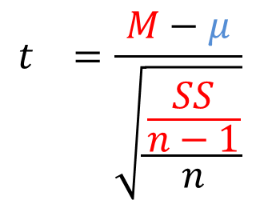
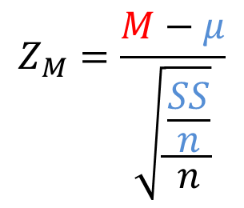
Your best Guess
Population is NOT known
?
σ
22
µ = 18
σ = ?
µ = ?
σ = ?
Retain H₀
Z-test :
T-test :
Estimated using sample
$$Z_{M}=\frac{M−μ}{\sqrt{\frac{\frac{SS}{n}}{n}}}$$
$$t_{}=\frac{M−μ}{\sqrt{\frac{\frac{SS}{n−1}}{n}}}$$
Z_{M}
Z_{M}
Notes:
Let’s write out the formulas for both Z and T statistics.
The only difference between the formulas is the way we calculate the variance.
We KNEW the variance before. Now we have to ESTIMATE it, that is guess with some degree of inaccuracy. Because of this inaccuracy that we introduce into hypothesis testing, we should be wrong more often. This is reflected in the shape of the distribution of sample means
(Compare distributions on page 278)

Slide 10
Your best Guess
Population is NOT known
?
σ
22
µ = 18
σ = ?
µ = ?
σ = ?
Retain H₀
Z-test :
T-test :
Estimated using sample
Observed Difference
Difference due to chance
Z_{M}
Z_{M}
Notes:
The reasoning behind the hypothesis testing, however, remains the same.
The only diff is that now we have to ESTIMATE (find out) the population variance

Slide 11
So what exactly is this
Difference due to chance
thing?
Notes:
How to compute it? (ESTIMATION)
What does it mean? What can it mean? ( COMPARISON=TESTING, INTERPRETATION)
This is how much means in the DSM vary on average
This is the average error when we estimate population mean from sample mean.
We can expect to be wrong about the population mean (inaccurate) by this much on average if using samples of this size.

Slide 12
One-Sample T-test
Example

Slide 13

H₀ : Boxers live 11 years
H₁ : No, something else
?
H₀ : µ = 11
H₁ : µ ≠ 11
µ = 11
σ = 2.3
µ = 11
σ = 2.3
$\overline{X}$ = 9
s = 2.3
14
14
13
13
12
12
11
11
10
10
9
9
8
8
7
7
6
6
5
Observed Difference
5
4
Difference due to chance
4
Notes:
We THINK that the population of boxer has the property of (mu)=11, for the lack of better evidence. Can this sample present us with the evidence to prove us wrong?
To answer this question we need to evaluate our hypotheses – to conduct a hypothesis test.
The test statistic, as we know is a ration of observed difference to different due to chance.
In other words, we need to evaluate what it is that our sample actually claims ( MEAN ), so that we could compare it with our guess. And secondly, we need to evaluate HOW WELL it claims it (STANDARD ERROR), or what inaccuracy would SHOULD expect.
How unsusual is it too see that boxer dog lives 9 years?
This is a question about the proportions in the Distribution of Sampling Means ( How extreme or unlikely this sample mean is?)
We know that the DSM has the mean of the population, so

Slide 14
H₀ : Boxers live 11 years
H₁ : No, something else
?
H₀ : µ = 11
H₁ : µ ≠ 11
µ = 11
σ = 2.3
µ = 11
σ = 2.3
$\overline{X}$ = 9
s = 2.3
14
14
13
13
12
12
11
11
10
10
9
9
8
8
7
7
6
6
5
M - µ
5
4
Difference due to chance
4
Notes:
This is what the sample CLAIMS:
the average life expectancy of a boxer dog is 9 years. (based on the sample of 10 dogs). Before collecting data, our guess was 11, if we get a sample that is REALLY different from 11, then we’d have to reject our statement in the NULL.
Now, how well does it claim it? How precise is this claim? How much should we expect it would be off by?

Slide 15
14
13
12
11
10
9
8
7
6
5
4
Notes:
Variance and Standard Error cartoon

Slide 16
14
13
12
11
10
9
8
7
6
5
4
Notes:
Variance and Standard Error cartoon

Slide 17
14
13
12
11
10
9
8
7
6
5
4
Notes:
Variance and Standard Error cartoon

Slide 18
14
13
12
11
10
9
8
7
6
5
4
Notes:
Variance and Standard Error cartoon

Slide 19
14
13
12
11
10
9
8
7
6
5
4
Notes:
Variance and Standard Error cartoon

Slide 20
14
13
12
11
10
9
8
7
6
5
4
Notes:
Variance and Standard Error cartoon

Slide 21
14
13
12
11
10
9
8
7
6
5
4
Notes:
Variance and Standard Error cartoon

Slide 22
14
13
12
11
10
9
8
7
6
5
4
Notes:
Variance and Standard Error cartoon

Slide 23
14
13
12
11
10
9
8
7
6
5
4
Notes:
Variance and Standard Error cartoon

Slide 24
s²
14
13
12
11
10
9
8
7
6
5
4
Notes:
Variance and Standard Error cartoon

Slide 25
s²
s²
14
13
12
11
10
9
8
7
6
5
4
Notes:
Variance and Standard Error cartoon

Slide 26
s²
14
13
12
11
10
9
8
7
6
5
4
Notes:
Variance and Standard Error cartoon

Slide 27
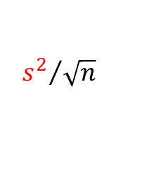
H₀ : Boxers live 11 years
H₁ : No, something else
?
H₀ : µ = 11
H₁ : µ ≠ 11
µ = 11
σ = 2.3
µ = 11
σ = 2.3
$\overline{X}$ = 9
s = 2.3
2.26
14
s²
14
13
13
12
12
11
11
10
10
9
9
8
8
7
7
6
6
5
M - µ
5
4
$${s^{2}}/{\sqrt{n}}$$
4
Notes:
We want to know how long boxer dogs may live. We start asking around and found 10 people who had boxers, so they reported how long each of their dogs lived. (Red squares)
Var = 5.11, SEM = .071, t(9)=2.80, p=.021
Interpret:
Bases on the sample of (M=10.00, n=10), boxers dogs appear to live less than 11 years. The difference between hypothesized and observed life duration is 2.8 times greater than we expected by chance ( sM=.071). There is only 2.1% chance that such or greater difference would occur purely due to sampling variability, which is smaller than we can safely tolerate ( alpha =.05). We reject the Null in favor of the Alternative.
One sample t-test with alpha of .05 indicated that the live duration of boxer dogs ( M, n) is signficantly different (lower) than 11, t(9)=2.8, p. , SEM.
The effect size is

Slide 28


H₀ : Boxers live 11 years
H₁ : No, something else
?
H₀ : µ = 11
H₁ : µ ≠ 11
µ = 11
σ = 2.3
µ = 11
σ = 2.3
$\overline{X}$ = 9
s = 2.3
2.26
14
s²
14
13
13
12
12
s_{M}
2
11
0.71
11
10
10
9
9
8
8
7
7
6
6
5
M - µ
5
4
$$s﷮M$$
4

Slide 29


Sampling Distribution
14
13
s²
12.4 years
12
-1.83
s_{M}
2
11
µ
95%CI
11
10
9
1.83
9
9.6 years
8
$$t_{crit}= ±1.83$$
7
$$df=n−1=9$$
6
5
1.83
4
Notes:
If you can remember all the mechanics, you don’t need more than three values to conduct hypothesis testing.

Slide 30
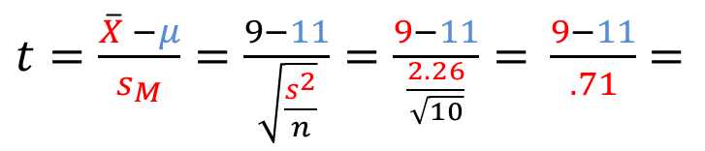
H₀ : Boxers live 11 years
H₁ : No, something else
?
H₀ : µ = 11
H₁ : µ ≠ 11
µ = 11
σ = 2.3
µ = 11
σ = 2.3
$\overline{X}$ = 9
s = 2.3
$t=\frac{\overline{X} −μ}{s_{M}}=\frac{9−11}{\sqrt{\frac{s^{2}}{n}}}=\frac{9−11}{\frac{2.26}{\sqrt{10}}}=$ $\frac{9−11}{.71}$ $=$
2
= -2.80
Sampling Distribution
s_{M}
2
11
2.26
s²
-1.83
µ
1.83
$$t_{crit}= ±1.83$$
d = .90
$$df=n−1=9$$
Reject H₀
9
M = 9
s = 2.3
µ = 11
σ = 2.3
One-sample t-test indicated that boxers (M = 9, s = 2.26, n = 10) live significantly less than 11 years, t(9) = -2.80, p<.05, SEM=0.71, , Cohen’s D =0.90.

Slide 31
One-Sample T-test
Scenario 3

Slide 32
H₀ :
H₁ :
?
µ = 13.5
σ = ?
µ = 13.5
σ = ?
µ = ?
σ = ?
Do programmer have greater need for control?
A psychologist wanted to determine whether computer programmers have a greater need for control than the typical person. The typical person scores an average of 13.5 on the CONTROL
personality inventory. The psychologist administered the CONTROL inventory to 36 computer programmers and found that the average need for control among them was 15 with a standard deviation of 4.9. Do programmers have a greater need for control than average population? Use an alpha of .05
16
15
14
13
12
11
10
9
7
6
5
Notes:
Step 1 : Formulate Hypothese

Slide 33

H₀ : No, they don’t
H₁ : Programmers need more control
?
H₀ : µ ≤ 13.5
H₁ : µ > 13.5
µ = 13.5
σ = 4.9
µ = 13.5
σ = 4.9
$\overline{X}$ = 15
s = 4.9
n=36
19
19
18
18
17
17
16
16
15
15
14
14
13
13
12
12
11
11
10
Observed Difference
10
9
Difference due to chance
9
Notes:
Identify information

Slide 34
H₀ : No, they don’t
H₁ : Programmers need more control
?
H₀ : µ ≤ 13.5
H₁ : µ > 13.5
µ = 13.5
σ = 4.9
µ = 13.5
σ = 4.9
$\overline{X}$ = 15
s = 4.9
19
19
18
18
17
17
16
16
15
15
14
14
13
13
12
12
11
11
10
M - µ
10
9
Difference due to chance
9

Slide 35
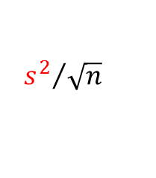
H₀ : No, they don’t
H₁ : Programmers need more control
?
H₀ : µ ≤ 13.5
H₁ : µ > 13.5
µ = 13.5
σ = 4.9
µ = 13.5
σ = 4.9
$\overline{X}$ = 15
s = 4.9
4.9
s²
19
19
18
18
17
17
16
16
15
15
14
14
13
13
12
12
11
11
10
M - µ
10
9
$${s^{2}}/{\sqrt{n}}$$
9

Slide 36
H₀ : No, they don’t
H₁ : Programmers need more control
?
H₀ : µ ≤ 13.5
H₁ : µ > 13.5
µ = 13.5
σ = 4.9
µ = 13.5
σ = 4.9
$\overline{X}$ = 15
s = 4.9
4.9
s²
19
19
18
18
17
17
2
16
s_{M}
0.82
16
15
15
14
14
13
13
12
12
11
11
10
M - µ
10
9
$$s﷮M$$
9

Slide 37
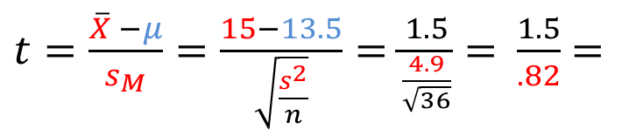


H₀ : No, they don’t
H₁ : Programmers need more control
H₀ : µ ≤ 13.5
H₁ : µ > 13.5
?
µ = 13.5
σ = 4.9
2
s_{M}
µ = 13.5
σ = 4.9
$\overline{X}$ = 15
s = 4.9
$t=\frac{\overline{X} −μ}{s_{M}}=\frac{15−13.5}{\sqrt{\frac{s^{2}}{n}}}=\frac{1.5}{\frac{4.9}{\sqrt{36}}}=$ $\frac{1.5}{.82}$ $=$
1.5
= 1.83
Sampling Distribution
s_{M}
13.5
2
4.9
s²
µ
1.68
$$t_{crit}= 1.68$$
s_{M}
0.82
2
$df=n−1=$35
d = .30
Reject H₀
15
µ = 13.5
σ = 4.9
M = 15
s = 4.9
One-sample t-test indicated that programmers(M = 15, s = 4.9, n = 36) have greater need for control than 13.5, t(35) = 1.83, p<.05, SEM=0.82, Cohen’s D =0.30.

Slide 38
One-Sample T-test
Scenario 4

Slide 39
H₀ :
H₁ :
?
µ = 40
σ = ?
µ = 40
σ = ?
µ = ?
σ = ?
Are grad students stressed more than general population?
A faculty member wanted to know how the stress levels of graduate students compares to the general population. The faculty member administered a stress test to 17 graduate students. Sample average was 50 with a standard deviation of 12. The stress test is known to have an average of 40 for the general population. Are graduate students stress more than the average population? Use an alpha of .05
70
65
60
55
50
45
40
35
30
25
20
Notes:
Step 1 : Formulate Hypothese

Slide 40

H₀ : Grad students are as stressed as everyone
H₁ : No, they are not
H₀ : µ = 40
H₁ : µ ≠ 40
?
µ = 40
σ = 12
µ = 40
σ = 12
$\overline{X}$ = 50
s = 12
n=17
70
70
65
65
60
60
55
55
50
50
45
45
40
40
35
35
30
30
25
Observed Difference
25
20
Difference due to chance
20
Notes:
Identify information

Slide 41
H₀ : Grad students are as stressed as everyone
H₁ : No, they are not
H₀ : µ = 40
H₁ : µ ≠ 40
?
µ = 40
σ = 12
µ = 40
σ = 12
$\overline{X}$ = 50
s = 12
70
70
65
65
60
60
55
55
50
50
45
45
40
40
35
35
30
30
25
M - µ
25
20
Difference due to chance
20

Slide 42
H₀ : Grad students are as stressed as everyone
H₁ : No, they are not
H₀ : µ = 40
H₁ : µ ≠ 40
?
µ = 40
σ = 12
µ = 40
σ = 12
$\overline{X}$ = 50
s = 12
12
s²
70
70
65
65
60
60
55
55
50
50
45
45
40
40
35
35
30
30
25
M - µ
25
20
$${s^{2}}/{\sqrt{n}}$$
20

Slide 43
H₀ : Grad students are as stressed as everyone
H₁ : No, they are not
H₀ : µ = 40
H₁ : µ ≠ 40
?
µ = 40
σ = 12
µ = 40
σ = 12
$\overline{X}$ = 50
s = 12
12
s²
70
70
65
65
60
2.91
60
55
55
50
50
45
45
40
40
35
35
30
30
25
M - µ
25
20
$$s﷮M$$
20

Slide 44
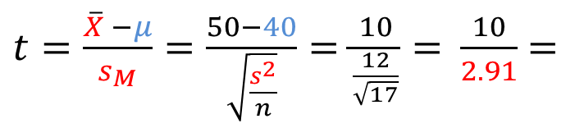


H₀ : Grad students are as stressed as everyone
H₀ : µ = 40
H₁ : µ ≠ 40
?
µ = 40
σ = 12
µ = 40
σ = 12
$\overline{X}$ = 50
s = 12
$t=\frac{\overline{X} −μ}{s_{M}}=\frac{50−40}{\sqrt{\frac{s^{2}}{n}}}=\frac{10}{\frac{12}{\sqrt{17}}}=$ $\frac{10}{2.91}$ $=$
10
= 3.41
Sampling Distribution
40
s²
-2.11
µ
2.11
$$t_{crit}= ±2.11$$
s_{M}
2
2.91
d = .83
$df=n−1=$16
Reject H₀
50
µ = 40
σ = 12
M = 50
s = 12
One-sample t-test indicated that graduate student(M = 50, s = 12, n = 17) were more stressed than general population, t(16) = 3.41, p<.05, SEM=2.91, Cohen’s D =0.83.
4.9
2
s_{M}
0.82

Slide 45
R-Square as Proportion of Variance Explained
Visual Guide

Slide 46


H₀ : Boxers live 11 years
H₁ : No, something else
H₀ : µ = 11
H₁ : µ ≠ 11
?
R²
µ = 11
σ = ?
µ = 11
σ = ?
µ = ?
σ = ?
$$(X_{i}−11)$$
$$(X_{i}−\overline{X})$$
14
14
13
13
12
12
11
11
10
10
9
9
8
8
7
7
6
6
5
5
4
4
Notes:
Another way to think about the hypothesis testing
We are comparing two different prediction system.
What are the prediction systems?
Whare are the prediction under each hypothesis.

Slide 47


H₀ : Boxers live 11 years
H₁ : No, something else
H₀ : µ = 11
H₁ : µ ≠ 11
?
R²
µ = 11
σ = ?
µ = 11
σ = ?
µ = ?
σ = ?
$$s^{2}$$
14
14
13
$$s﷮M$$
13
12
12
11
11
10
SS=86
10
9
SS = 46
9
8
8
7
7
6
6
5
5
4
4
Notes:
How much better does H1 represent reality than H0?
How much smaller is red error than blue error?
We make two predictions:
one based on a general status quo, gut feeling, nothing really,
second based on the sample data.
How much better are we doing “guessing” the true population parameter using sample data rather than using only our intuition?
SST (blue) = 86, SSE (red) = 46, R² = .465

Slide 48
H₀ : Boxers live 11 years
H₁ : No, something else
H₀ : µ = 11
H₁ : µ ≠ 11
?
R²
µ = 11
σ = ?
µ = 11
σ = ?
µ = ?
σ = ?
$$s^{2}$$
14
SSE = 46
14
13
$$s﷮M$$
13
12
12
11
11
10
SST = 86
10
9
SSE = 46
9
8
8
7
7
6
SST
SST -SSE
6
5
R² =
5
4
4
Notes:
Just like, cohen’s D, there are rule of thumbs interpreting the value of R²
.01 < R² < .09 – Small
.09 < R² < .25 – Medium
.25 < R² - Large

Slide 49
46
SST = 86

Slide 51
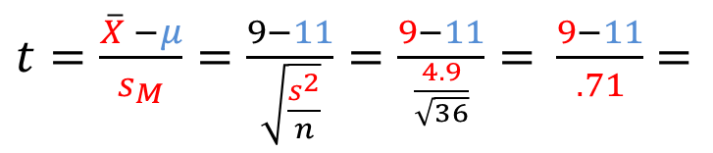
H₀ : Boxers live 11 years
H₁ : No, something else
?
H₀ : µ = 11
H₁ : µ ≠ 11
µ = 11
σ = 2.3
µ = 11
σ = 2.3
$\overline{X}$ = 9
s = 2.3
$t=\frac{\overline{X} −μ}{s_{M}}=\frac{9−11}{\sqrt{\frac{s^{2}}{n}}}=\frac{9−11}{\frac{4.9}{\sqrt{36}}}=$ $\frac{9−11}{.71}$ $=$
2
= -2.80
Sampling Distribution
s_{M}
2
11
2.23
s²
-1.83
µ
1.83
$$t_{crit}= ±1.83$$
d = .90
$$df=n−1=9$$
Reject H₀
9
M = 9
s = 2.3
µ = 11
σ = 2.3
One-sample t-test indicated that boxers (M = 9, s = 2.23, n = 10) live significantly less than 11 years, t(9) = -2.80, p<.05, SEM=0.71, , Cohen’s D =0.90.

Slide 52
14
13
13
s²
12.4 years
12
-1.83
s_{M}
2
11
µ
95%CI
11
10
9
$$t_{crit}= ±1.83$$
1.83
9.6 years
8
$$df=n−1=9$$
7
6
5
1.83
4
Notes:
If you can remember all the mechanics, you don’t need more than three values to conduct hypothesis testing.

Slide 53


H₀ : Males Boxers live as long as Females
H₁ : No, they are different
?
H₀ : µ_{male} = µ_{female}
H₁ : µ_{male} ≠ µ_{female}
µ = 9
σ = 2.3
$X$ = 10.4
s= 1.81
$\overline{X}$ = 9.6
s = 1.81
14
14
13
G
13
12
12
11
G
G
11
10
10
9
G
9
8
G
8
7
7
6
6
5
5
4
4

Slide 54
H₀ : Males Boxers live as long as Females
H₁ : No, they are different
?
H₀ : µ_{male} = µ_{female}
H₁ : µ_{male} ≠ µ_{female}
µ = 9
σ = 2.3
$X$ = 10.4
s= 1.81
$\overline{X}$ = 9.6
s = 1.81
14
14
13
G
13
12
12
11
G
G
11
10
10
9
G
9
8
G
8
7
7
6
6
5
5
4
4

Slide 55
H₀ : Males Boxers live as long as Females
H₁ : No, they are different
?
H₀ : µ_{male} = µ_{female}
H₁ : µ_{male} ≠ µ_{female}
µ = 9
σ = 2.3
$X$ = 10.4
s= 1.81
$\overline{X}$ = 9.6
s = 1.81
14
14
13
G
13
12
12
11
G
G
11
10
10
9
G
9
8
G
8
7
7
6
6
5
5
4
4

Slide 56
H₀ : Males Boxers live as long as Females
H₁ : No, they are different
?
H₀ : µ_{male} = µ_{female}
H₁ : µ_{male} ≠ µ_{female}
µ = 9
σ = 2.3
$X$ = 10.4
s= 1.81
$\overline{X}$ = 9.6
s = 1.81
14
14
13
G
13
12
12
11
G
G
11
10
10
9
G
9
8
G
8
7
7
6
6
5
5
4
4

Slide 57
H₀ : Males Boxers live as long as Females
H₁ : No, they are different
?
H₀ : µ_{male} = µ_{female}
H₁ : µ_{male} ≠ µ_{female}
µ = 9
σ = 2.3
$X$ = 10.4
s= 1.81
$\overline{X}$ = 9.6
s = 1.81
14
14
13
G
13
12
12
11
G
G
11
10
10
9
G
9
8
G
8
7
7
6
6
5
5
4
4
Notes:
That’s how much error we saved
We express 10 data points as a single score and erred total of SST
We expressed 10 data points as two scores and erred the total of SSE
We increased the complexity by 1 degree of freedom
We decreased the error of prediction by SSR total

Slide 58
H₀ : Males Boxers live as long as Females
H₁ : No, they are different
?
H₀ : µ_{male} = µ_{female}
H₁ : µ_{male} ≠ µ_{female}
µ = 9
σ = 2.3
$X$ = 10.4
s= 1.81
$\overline{X}$ = 9.6
s = 1.81
14
14
13
MSR
MSE
G
13
12
12
11
F
G
G
11
10
10
9
G
9
8
G
8
7
7
6
6
5
5
4
4
Notes:
The SS/df for the the H0 is MSE, the error = the average difference between scores and the mean under H0

